Slide 1
SIAA311 – Title Defense
Advanced Aquarium Care: A Mini-Computer Device Driven Solution for Real-Time pH, Temperature Monitoring, and Automated Feeding
Secure Boot Authentication: Implementing a QR-Based Access Control System for Computer Startup
Innovative Underwater Recovery: A Mini-Computer Powered Submersible Robot for Locating and Retrieving Lost Objects
P.L.A.N.E.T.: Portable Luminol Analysis for Navigating Evidence Trails
I.M.A.G.E.: Intelligent Medical Analysis and Guidance Engine
Mac Hideyoshi P. Asoi
Ceejay C. Imperial
Jamier Ivan Madrid
Paul Gerald T. Sebastian

Slide 2

ADVANCED AQUARIUM CARE: A MINI-COMPUTER DEVICE DRIVEN SOLUTION FOR REAL-TIME PH, TEMPERATURE MONITORING, AND AUTOMATED FEEDING
Mac Hideyoshi P. Asoi
Ceejay C. Imperial
Jamier Ivan Madrid
Paul Gerald T. Sebastian

Slide 3

INTRODUCTION
Integration of technology and environmental management has produced game-changing innovations for several fields in recent years.
Aquatic ecosystems have traditionally relied on manual, labor-intensive procedures for upkeep and preservation.
Sophisticated technologies, such as embedded systems and microcomputers, offer automated and efficient solutions for aquatic management.
Raspberry Pi technology is integrated for a unique approach to aquarium management.
This paper presents a comprehensive system built for automated control of key parameters and real-time monitoring of aquarium conditions.

Slide 4
BACKGROUND
Managing an aquarium has always been a difficult task that calls for close attention to the environmental factors that have an impact on the health and welfare of aquatic life.
Techniques for keeping an eye on and sustaining aquarium characteristics like pH, temperature, and feeding schedules
Manual management is prone to human error, potentially leading to suboptimal conditions for aquatic life.

Slide 5
STATEMENT OF THE PROBLEM
Environmental conditions must be continuously monitored and controlled in an effective aquarium.
Conventional approaches of controlling key variables, like pH levels, temperature, and feeding schedules, are often labor-intensive and prone to errors.
Restrictions lead to uneven data gathering, a delay in problem identification, and ineffective management techniques.
A more dependable, automated system that incorporates real-time monitoring and control is required.

Slide 6
MAIN PROBLEM
Absence of a thorough and automated system for the automatic feeding schedules and real-time monitoring and management of important aquarium parameters like pH and temperature.

Slide 7
SPECIFIC PROBLEM
Inconsistent Monitoring and Data Collection
Manual Testing Limitations: Traditional methods require periodic manual testing
Lack of Real-Time Data: absence of continuous monitoring
Delayed Corrections: corrective actions to address parameter deviations are often delayed
Limited Automation: requiring manual intervention and increasing the risk of human error.
Inconsistent Feeding Schedules: may not provide consistent or precise feeding, leading to overfeeding or underfeeding

Slide 8
SPECIFIC PROBLEM
Labor-Intensive Management: manual feeding requires frequent attention from the aquarium owner
Fragmented Solutions: involving multiple devices and interfaces that complicate the setup and management
User-Friendliness: The lack of a unified platform for managing all aspects

Slide 9
OBJECTIVE OF THE STUDY
The primary objective of this study is to develop and evaluate a Raspberry Pi-based system for advanced aquarium care that integrates real-time monitoring and automation to improve the management of critical parameters such as pH, temperature, and feeding schedules
Implement Real-Time Monitoring
Develop a System for Continuous Data Collection
Establish Automated Feeding
Provide Real-Time Alerts:
Design a Unified Interface
Simplify Setup and Maintenance

Slide 10
GENERAL OBJECTIVE
The general objective of this study is to develop and evaluate a comprehensive Raspberry Pi-based system for advanced aquarium care, which integrates real-time monitoring and automation to enhance the management of pH levels, temperature, and feeding schedules. This system aims to improve the accuracy, efficiency, and ease of maintaining optimal conditions for aquatic life.

Slide 11
SPECIFIC OBJECTIVES
Real-Time pH and Temperature Monitoring
Design and Implement Monitoring Tools
Enable Real-Time Data Display and Alerts
Automated Environmental Control
Automate Parameter Adjustments
Develop Responsive Control Systems
Automated Feeding Mechanism
Design and Implement Feeding Automation
Ensure Consistency and Reliability
Data Logging and Analysis
Establish Data Logging Capabilities

Slide 12
SPECIFIC OBJECTIVES
Provide Analytical Tools
User-Friendly Interface and Integration
Create an Integrated User Interface
Simplify System Setup and Maintenance

Slide 13
SCOPE & LIMITATION
SCOPE
- The scope of this study encompasses the development, implementation, and evaluation of a Raspberry Pi-based system designed to automate and enhance aquarium care.
LIMITATION
- Sensor Limitations
- System Complexity and Cost
- Aquarium Variations
- Device Compatibility

Slide 14
SIGNIFICANCE OF THE STUDY
holds significant implications for various stakeholders in the field of aquarium management.
potential to revolutionize aquarium management through the application of Raspberry Pi technology

Slide 15
Secure Boot Authentication: Implementing a QR-Based Access Control System for Computer Startup
Mac Hideyoshi P. Asoi Ceejay C. Imperial Jamier Ivan Madrid Paul Gerald T. Sebastian
Information Technology
College of Computer Studies
Research Development and Innovation Center
Our Lady of Fatima University

Slide 16
Introduction
Importance of safeguarding computer networks against illegal access.
Conventional methods protect after system initiation.
Novel approach: QR-based authentication before computer power-on.
Ensures only authorized users can start the computer.

Slide 17
Background of the Study
Conventional startup procedures lack safeguards against unwanted physical access.
Pre-boot authentication requires user verification before system boot.
QR codes provide efficient data encoding and transmission.
Enhances security by allowing only authorized users to start the computer.

Slide 18
Statement of the Problem
Essential to protect computer systems from unauthorized access.
Conventional methods do not address risks before OS loading.
Need a way to prevent computer startup until verified by an authorized user.

Slide 19
Main Problem
Lack of pre-boot authentication leads to security risks.
System can be accessed or altered by unauthorized users.

Slide 20
Specific Problem
Authentication Mechanism: How to effectively implement a QR code-based system?
System Integration: Technological concerns in integrating QR code authentication.
User Experience: Impact on convenience and efficiency.

Slide 21
Objective of the Study
Design, develop, and evaluate a QR code-based pre-boot authentication system.
Ensure only users with valid QR codes can power on the computer.
Enhance security by adding user-specific authentication.

Slide 22
General Objective
Enhance computer security by implementing QR code-based pre-boot authentication.
Prevent unauthorized access before computer startup.

Slide 23
Specific Objectives
Design and implement QR code-based authentication system.
Evaluate system effectiveness in preventing unauthorized access.
Analyze user experience and identify areas for improvement.

Slide 24
Scope and Limitation
Focus on developing and evaluating the QR code-based pre-boot system.
Scope: Design, integration with hardware, and security assessment.
Limitations: Hardware compatibility, controlled environment testing, and user experience variability.

Slide 25
Significance of the Study
Potential to advance computer security with novel pre-boot authentication.
Addresses critical gap in traditional security protocols.
Broad implications for individuals and organizations with high-security needs.

Slide 26
Conclusion
Summary of the proposed QR-based authentication system.
Key points on enhancing security and preventing unauthorized access.
Future implications for cybersecurity advancements.

Slide 27
Innovative Underwater Recovery: A Mini-Computer Powered Submersible Robot for Locating and Retrieving Lost Objects
Presented By :
Mac Hideyoshi P. Asoi
Ceejay C. Imperial
Jamier Ivan Madrid
Paul Gerald T. Sebastian

Slide 28

OVERVIEW
This study presents a mini-computer powered submersible robot designed to enhance the efficiency and safety of underwater recovery operations.
Traditional methods, such as large equipment or human divers, are often cumbersome and risky; this new approach aims to address those challenges.
3

Slide 29



INTRODUCTION
Recovering lost objects from underwater environments is challenging
This study presents a solution through a mini- computer powered submersible robot
The robot aims to enhance safety, reduce costs, and overcome limitations of existing recovery methods
2

Slide 30
BACKGROUND
Underwater recovery operations are often done with large equipment or human divers
1
Advances in robotics and miniaturization technology provide new opportunities for improving these operations
2
This study explores the development of a mini-computer powered submersible robot
3
Underwater recovery is hindered by limitations in depth, visibility, and operational risks. The use of mini-computers can significantly improve the navigation and retrieval abilities of underwater robots, leading to safer and more efficient recovery processes.
-
5

Slide 31
PROBLEM
The primary issue is the inefficiency and high risk associated with conventional underwater recovery techniques. There’s a pressing need for a more advanced solution that offers better performance in locating and retrieving submerged objects.
First Problem
Traditional methods of underwater recovery are inefficient and risky
Second Problem
There is a need for a more effective, safe, and cost-efficient solution
Third Problem
This study seeks to address this need by exploring the development of a mini- computer powered submersible robot
4

Slide 32
OBJECTIVE OF THE STUDY
Objective 1
The objective of this study is to design, develop, and evaluate a mini- computer powered submersible robot
Objective 2
The robot aims to locate and retrieve lost objects more effectively than traditional methods
Objective 3
The study will assess the performance of the robot in various underwater conditions and compare its effectiveness with existing recovery methods
7

Slide 33
SPECIFIC PROBLEMS
Design & Functionality
How to create a robot that navigates effectively and retrieves objects efficiently.
Integration & Performance
Addressing technical challenges in combining mini-computer technology with underwater
Safety & Cost Efficiency
Evaluating how the new robot compares with traditional methods regarding operator safety and cost- effectiveness.
robotics.
9

Slide 34
SPECIFIC OBJECTIVE
Design & Functionality
Create a robot capable of precise navigation and autonomous retrieval.
Integration & Performance
Evaluate its performance against existing methods in various
Safety & Cost Efficiency
Analyze safety and cost implications compared to traditional techniques.
underwater conditions.
9

Slide 35
SCOPE & LIMITATIONS
The study focuses on designing and testing a submersible robot for underwater recovery tasks, assessing its potential advantages over traditional methods.
First Limit
Environmental conditions for testing may not cover all real-world scenarios.
Second Limit
Limitations include environmental conditions, hardware constraints, and user testing scope
Third Limit
User testing will have a limited number of participants, affecting broader applicability.
4

Slide 36
SIGNIFICANCE OF THE STUDY
The study introduces a novel approach to underwater recovery operations through the development of a mini-computer powered submersible robot This research could revolutionize underwater recovery practices by offering a more reliable, safe, and cost-effective solution.
The findings are expected to benefit salvage operations, environmental monitoring, and search and rescue missions.
The robot has the potential to revolutionize current recovery practices by minimizing risks and improving operational effectiveness .
The findings of this study could benefit various sectors, including salvage operations, environmental monitoring, and search and rescue missions
12

Slide 37
P.L.A.N.E.T.: Portable Luminol Analysis for Navigating Evidence Trails
Mac Hideyoshi P. Asoi
Ceejay C. Imperial
Jamier Ivan Madrid
Paul Gerald T. Sebastian

Slide 38
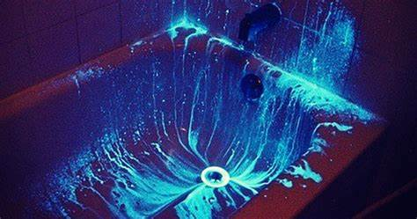
Introduction
Crime scene investigation and biological evidence detection.
Traditional luminol testing is cumbersome and time-consuming.
Solution: Development of P.L.A.N.E.T., a portable luminol testing tool.

Slide 39

Background q&a sessions
Forensic science evolution faces challenges in detecting biological evidence.
Raspberry Pi technology enables portable luminol testing.
Goal: Improve evidence collection in underserved areas.

Slide 40

Problem Statement
Main Problem: Lack of accessible and user-friendly luminol tools.
Specific Problems: Complexity, lack of portability, delayed results, inconsistent application, limited forensic tools.

Slide 41
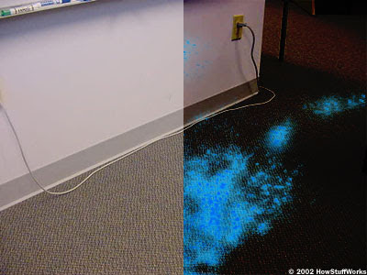
Objectives
General Objective: Develop a portable luminol tool for efficient crime scene investigations.
Specific Objectives: Tool design, user-friendly controls, field tests, law enforcement collaboration.

Slide 42
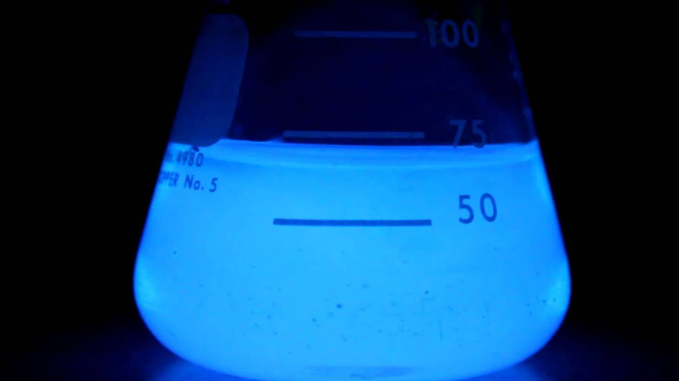
Scope and Limitations
Scope: Target users, functionality, field testing in diverse environments.
Limitations: Environmental factors, training, resource constraints.

Slide 43
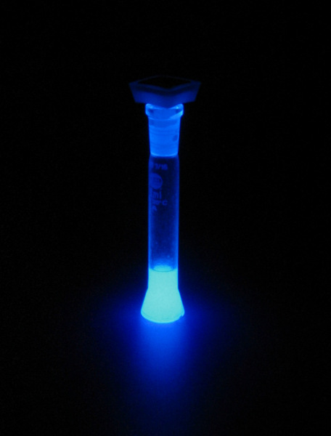
Significance of the Study
Impact: Enhanced efficiency in detecting biological evidence.
Benefit: Provides forensic tools for underserved areas.
Contribution: Foundation for future forensic technology innovations.

Slide 44
I.M.A.G.E.: Intelligent Medical Analysis and Guidance Engine
Mac Hideyoshi P. Asoi
Ceejay C. Imperial
Jamier Ivan Madrid
Paul Gerald T. Sebastian

Slide 45
Introduction
The I.M.A.G.E. project leverages AI and machine learning to assist healthcare professionals in analyzing medical images. It aims to improve diagnostic accuracy and patient outcomes.

Slide 46

Background of the Study
Medical imaging like X-rays, MRIs, and CT scans are crucial but complex to interpret. I.M.A.G.E. bridges the gap by providing actionable insights and reducing radiologists' cognitive load.

Slide 47

Statement of the Problem
Healthcare professionals face delays and inaccuracies in interpreting large volumes of medical images. There is a need for intelligent systems to streamline analysis and improve patient care.

Slide 48
Main and Specific Problems
Main Problem: Inefficiency in image interpretation.
Specific Problems: High workload, diagnostic variability, delays in patient care, limited AI integration.

Slide 49
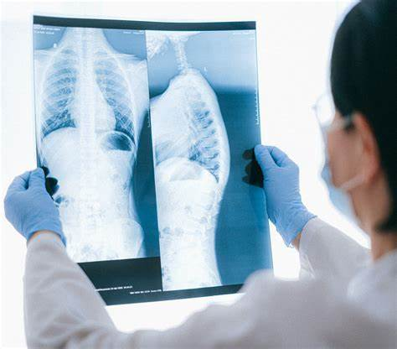
Objectives of the Study
General Objective: To create a medical imaging tool using AI.
Specific Objectives: Algorithm development, user-friendly interface, clinical workflow integration, validation, and training.

Slide 50
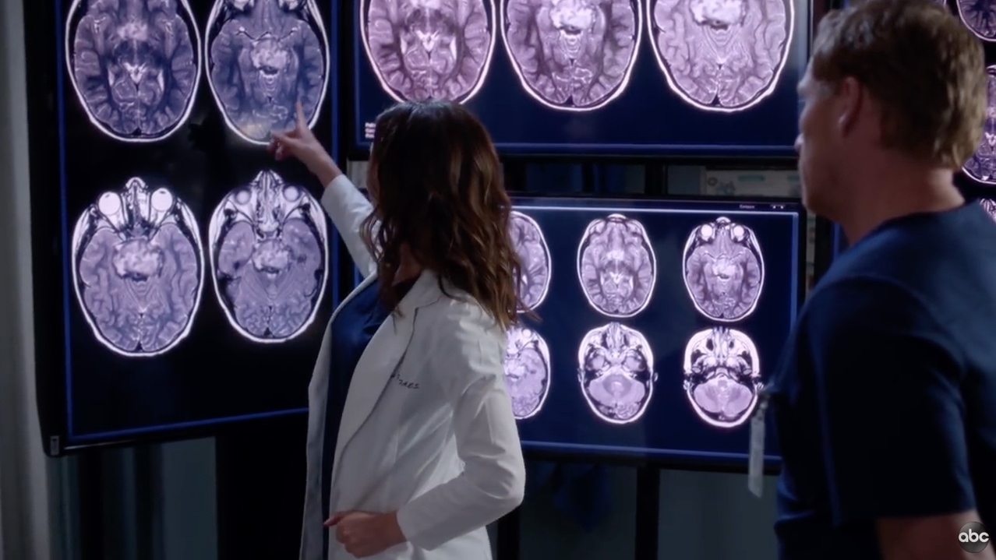
Scope and Limitations
Scope: The tool will analyze X-rays, MRIs, and CT scans for medical professionals.
Limitations: Accuracy depends on image quality; algorithms need training on diverse datasets.

Slide 51
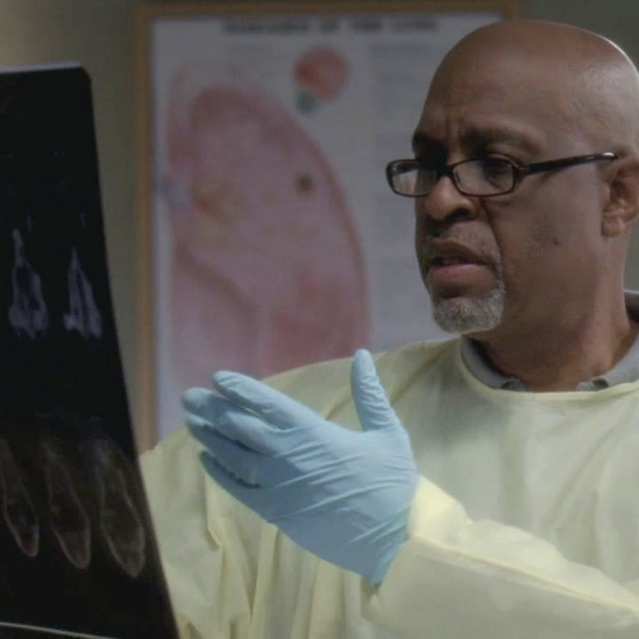
Significance of the Study
The I.M.A.G.E. project enhances diagnostic accuracy, reduces errors, and improves patient outcomes. It supports healthcare professionals, especially in resource-limited settings.

